Slide 1


Telegram BOT
Bakbergen Beishenaliev Utkelbaev Chyngyz

Slide 2

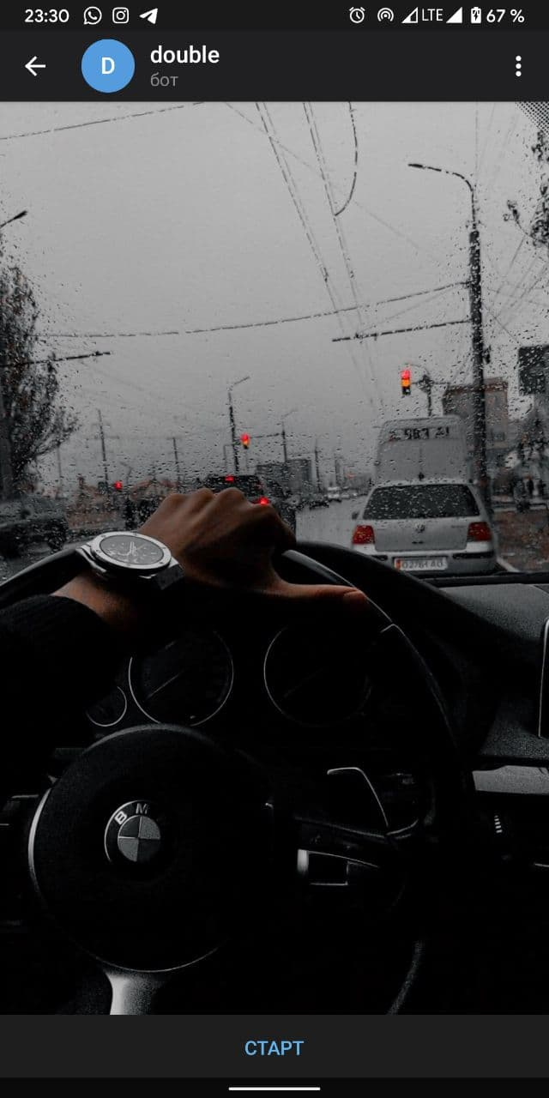
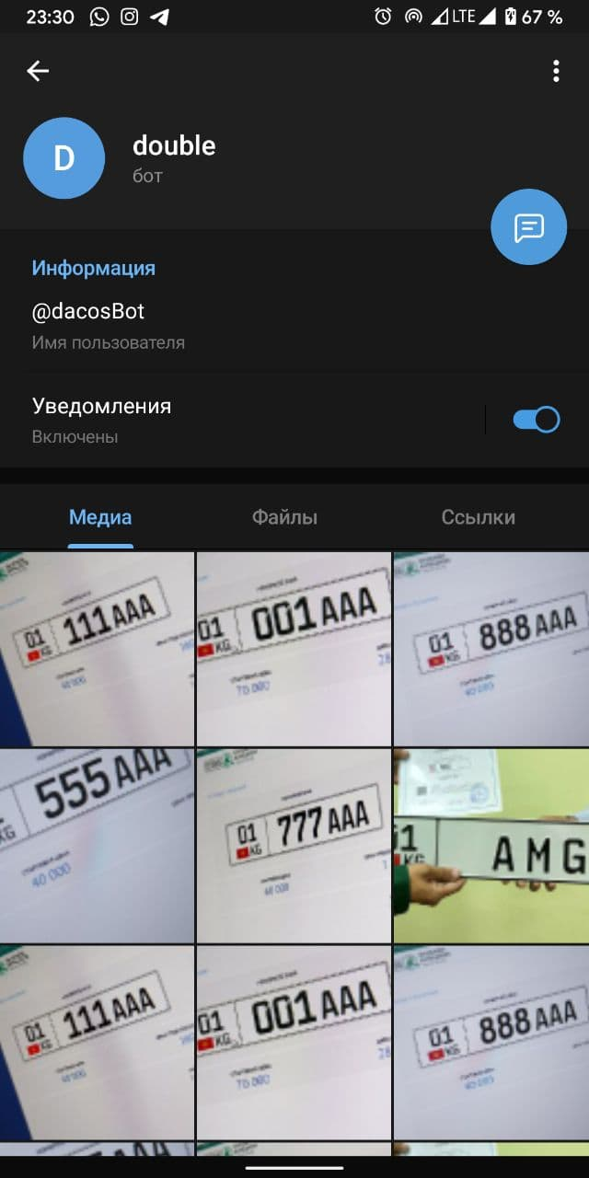
Double Bot
Double bot give information about gosnomer.
Language is Russian.
You can chatting with bot, press start button.

Slide 3

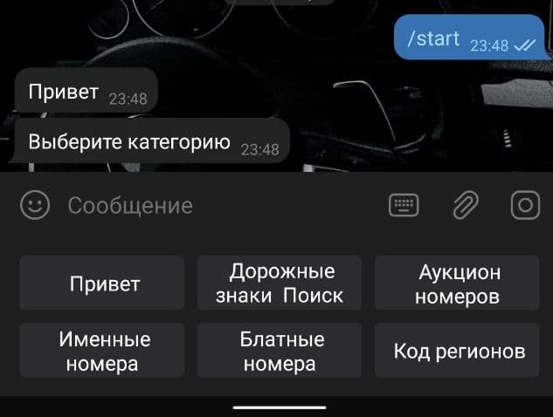
Аукцион номеров
Именные номера
01
03
Блатные номера
Код регионов
02
04
In our bot have menu and 4 important buttons
Press this button you will see auctions number of the cars.
Press this button you will see name numbers of the cars.
Press this button you will see beautiful number of the cars.
Press this button will see region code number of the car.

Slide 4

ABOUT our BOT
Our bot contain information about car numbers. Shows which number of cars are available. How much will these car numbers cost. Also you can read interesting information. And see the region code numbers of the car.

Slide 5

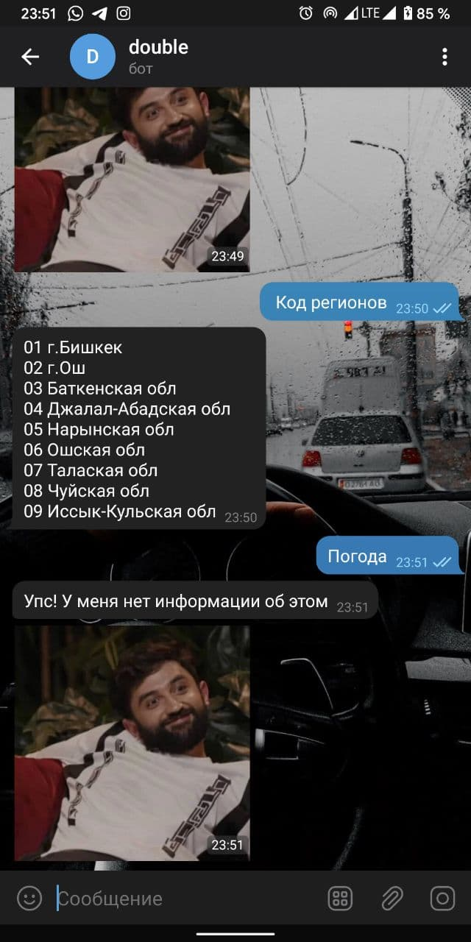
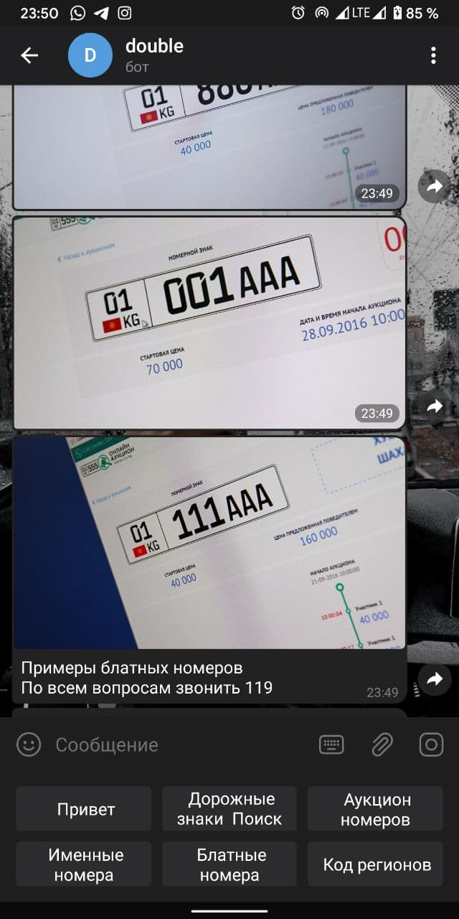
Screenshots

